Slide 1
Car Price Prediction Project

Slide 2
Problem Statement
To predict the price for the used cars.
The data for this project was scraped using selenium webdriver from carswale.com website.

Slide 3
Background
Since large number of used cars are being sold and purchased each year, determining whether the price listed on the website is genuine becomes an uphill task considering the amount of various factors that are involved in the market.
Data science can play a key role in this domain by not only helping the customers get the car of their choice based on their requirements, but also help the selling party find the best price for their used car.

Slide 4
Web Scrapping
More than 5000 used cars from more than 15+ cities were extracted using selenium web driver.
There are total of 32 brands and 1355 different model in the dataset ranging from hatchback to sedan to Suvs of both luxury and non luxury brands.

Slide 5
EDA Procedure
First step is to get insight of the dataset by determining the shape of data and finding the data type.
Next we perform null value analysis ,
Blank string values observed in some features were replaced with null values and later replaced with mean (for non-categorical features) and mode (for categorical features).
Mislabeled feature datatypes were relabeled.

Slide 6
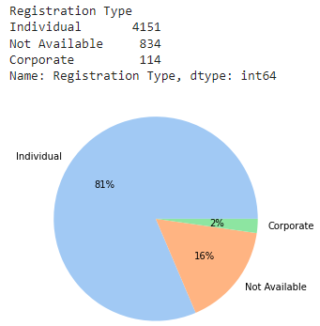
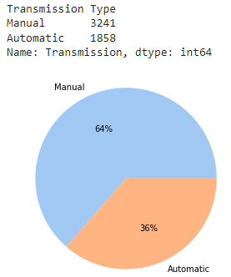
Using visualization techniques we perform univariate, bivariate analysis.

Slide 7
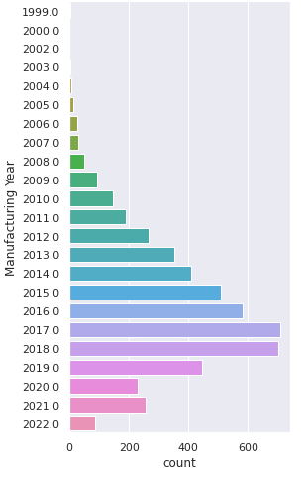
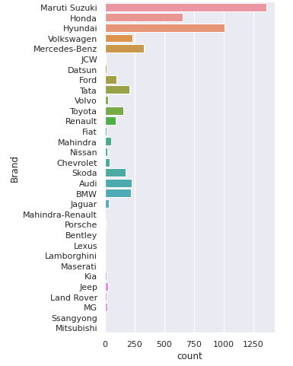
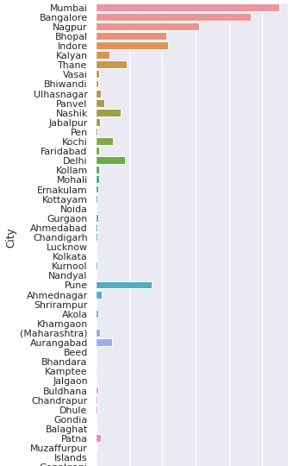

The manufacturing year for car ranges from 1999 to 2022.
2017 followed by 2018 have highest number of used cars for sale.
Maruti Suzuki followed by Hyundai are the major brand with maximum
used cars up for sale.
Mumbai followed by Bangalore city have highest number of cars available for
sale.

Slide 8
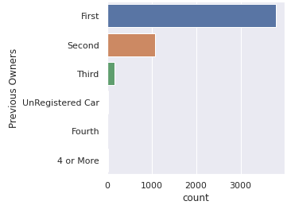
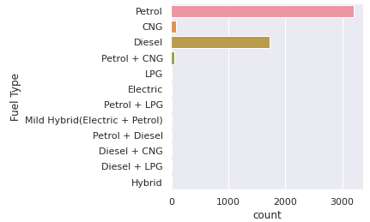
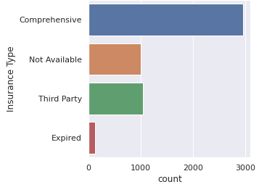
Cars with one owner have the highest count in the
dataset.
Petrol cars followed by diesel cars have the highest
count.
Majortty of the cars have comprehensive insurance type.

Slide 9
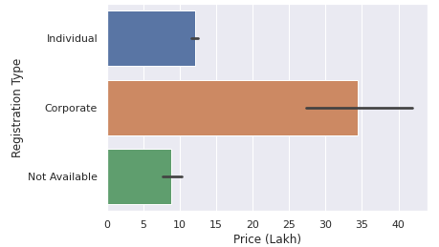
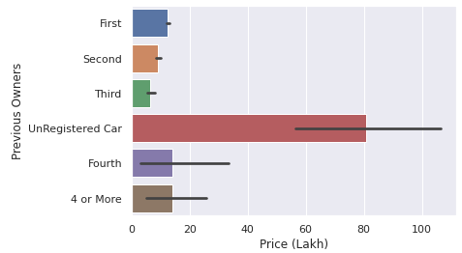
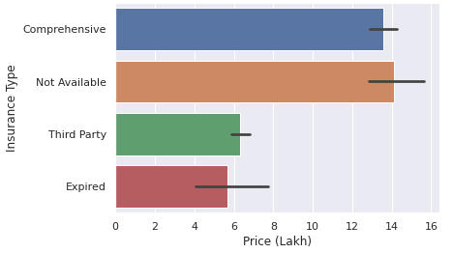
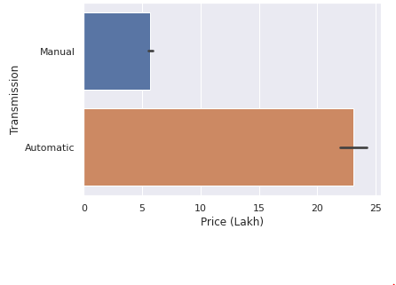
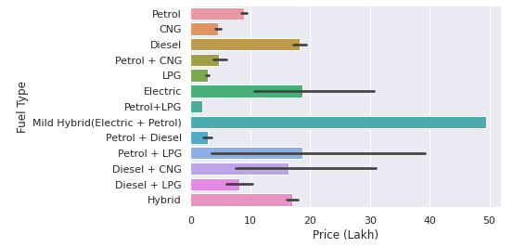
Corporate registered type are more expensive than
individual registered vehicles.
Unregistered cars are costlier than cars with atleast
one previous owner.
Used cars with comprehensive insurance type are
more expensive than other.
Hybrid cars as well as cars that are automatic
transmission type have very high price.

Slide 10
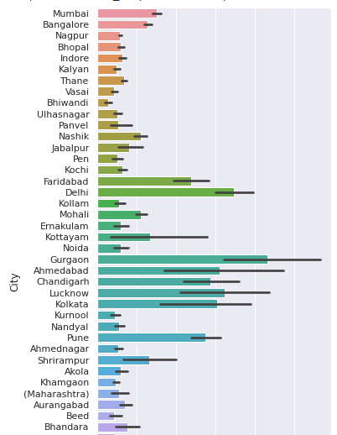
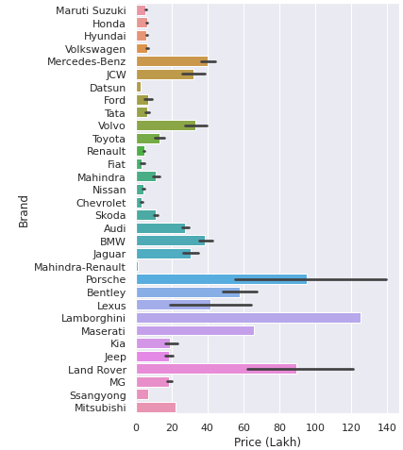
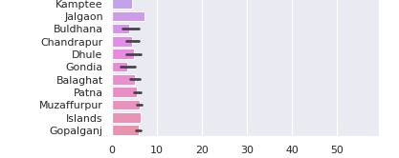
Gurgaon followed by Delhi city have highest selling
price for used cars.
Petrol cars followed by diesel cars have the highest
count.
Lamborgini followed by porsche are two highly expensive
brand among all the used cars in dataset.

Slide 11
Outliers analysis performed to handle extreme values. This is followed by skew analysis to handle the skewness in the data.
Next we split the dataset into input and target features.
Based on the analysis, we encode the input and output categorical features either using label encoder (for nominal data) or ordinal encoder (for ordinal data)

Slide 12
Since the data doesn’t have gaussian Min-Max normalization is performed to rescale data between 0 and 1.
Further, the train_test split is performed with 20% data reserved for test set and 80% for train set.
We test dataset using different model to find best fit model.
Model with least mean absolute error is saved.

Slide 13
Conclusion
In this study we found that bagging regression algorithm performs slightly better than random regression and rest of the algorithm tested.
Length, width, wheelbase, engine, kerb weight, manufacturing year, fuel capacity, max power, max torque are the top features of the used cars that highly impact the sale price among all the features in the dataset.

